Slide 1

Privacy Preserving Graph Publication

Slide 2







Social Network Benefits
Anonymized Data
(…)
(…)
(…)
Facebook
(…)
(…)
Government
Advertiser
Analyze and reveal some privacy information
Web agents
Marketing
Customers
Users
Notes:
[1] Social networks are getting more and more popular usage in recent years. As a result, studying and mining on the social networks become more and more important. For example, government can make proper policy to prevent the spreading of a certain disease by studying the spreading its rules. A company can issue advertisement more efficiently by studying how people influence each other. A social network website needs to publish its data to some customers.
[2] However, the social network data cannot be directly released due to the privacy request of the users who involve in the social network.
[3] The graph data must be sanitized before publishing to void the customers to analyze or reveal some privacy information.
[4] The customers here refer to the people who use the published data. And the users refer to the social network users who join those networks.

Slide 3
Protection Methods
Two methods
Publishing sanitized graph
Publishing noised aggregate information
Differential privacy on graph
Notes:
Basically, there are two methods to publish a privacy preserving graph.
The first method is to publish a sanitized graph instead of the original graph. The sanitized graph guarantees that certain privacy protection objectives can be achieved.
The second method is to publish the noised aggregate information of the original graph. To guarantee the aggregate information do not release personal private information,
the noise adding mechanism should satisfy the differential privacy protection requirement.
Next, let’s introduce these two methods.

Slide 4
Publishing sanitized graph
Privacy protection and the attack models
Preventing passive attacks
Preventing active attacks
Other works

Slide 5
Publishing sanitized graph
Privacy protection and the attack models
Preventing passive attacks
Preventing active attacks
Other works

Slide 6
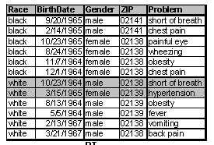
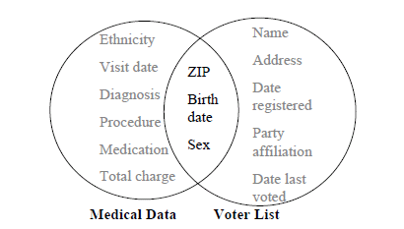
Attack the Anonymized Data
An attacker
Background knowledge
The information he knows about a victim
Sensitive information
The information that user cares
Hospital Data
Notes:
[1] Privacy protection for tabula data has been well studied in recent years. Let’s briefly review how an attacker attacks the published anonymized data.
[2] When publishing a table, this table may contain both the public available information and sensitive information about users. For example, a hospital needs to publish its patient data to some researchers. Besides the disease each patient has, the data also contains the information such as Zip code, Birth date etc. While the information such as Zip code, Birth date are public available from the published voter list. So, even the hospital has removed all the names of patients, the diseases of some users are still released.
[3] The public available information that an attacker can use to attack the anonymized data is called the “background knowledge”.
[4] The sensitive information that a user does not want others to know is called the “sensitive information”. The anonymized data should be carefully designed before publishing to make sure the sensitive information is safe according to the corresponding background knowledge. The process that an attacker use the back ground knowledge around a user to learn his sensitive information is called the node re-identification.
[5] There are a lot of works have been done to publish tabular data

Slide 7
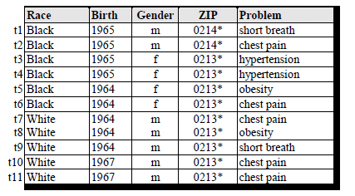
Attack the Anonymized Data
An attacker
Background knowledge
The information he knows about a victim
Sensitive information
The information that user cares
2-Anonymous Hospital Data
Notes:
[1] For example, a 2-anonymouse table can be published. In which there are at least two tuples for any background knowledge. There are also many other models have been developed, such as l-diversity, t-closeness etc.
[2] However, a social network is a graph. A graph is a more complex data structure than tabular data. How to publish a privacy preserved social network becomes a challenge problem.

Slide 8
Information in Social Networks
Graph
Structure Information
Attributes Information
Sub-graph
degree
Attributes of Nodes
Attributes of edge
Node relationship
Weight
Traditional Tabular data
[1] normal labels background knowledge
[2] sensitive labels protected information
[1] Sensitive information
[2] Background knowledge
Background knowledge
Attack Demo
Sensitive information
Notes:
[1] Besides the attributes on nodes and edges, a graph also contains the connection information between users. We call the connection between users as the structure information.
[2] The structure information contains the information such as node degrees, the subgraph around a user etc.
[3] For the attributes of nodes, it can be seen as the traditional tabular data. The normal attributes of a node work as the background knowledge and the sensitive attributes of a node is the information that should be protected.
[4] In a lot of applications, their social networks are represented as weighted graphs. The weights on edges are new information that is different with the traditional tabular data. In some applications, such as the discussion network of a forum, the weights on edges work as background knowledge to re-identify nodes. In some applications, such as the cooperation network of companies, the edge weights themselves are sensitive information which should be protected.
[5] Besides the attributes information, the structure information brings new challenges to protection too. The structure information can be used as background knowledge to do the attack.
(Jump to the attack demonstration slides)

Slide 9
Information in Social Networks
Graph
Structure Information
Attributes Information
Sub-graph
degree
Attributes of Nodes
Attributes of edge
Node relationship
Weight
Traditional Tabular data
[1] normal labels background knowledge
[2] sensitive labels protected information
[1] Sensitive information
[2] Background knowledge
Background knowledge
Attack Demo
Sensitive information
Notes:
(Jump back from the attack demonstration slides)
[6] Furthermore, in some applications, the social relationship between users is also sensitive.
[7] All these bring new challenges to publish a social network.

Slide 10
Protection objectives
Graph Model | Protection |  | Works
Unweighted Graph | Node Protection (Anti Node re-identification) |  | [8][12][13][14] [15][21][22][23]
 | Link Protection |  | [13][22]
 |  |  | [13]
Weighted Graph | Edge weights | Hide the real edge weights | [17][24]
 |  | Hide the relative order between weights | [24]
Notes:
[1] The current works on graph protection focus on the following three objectives respectively
[2] The first is to avoid node re-identification. Node re-identification is to correctly re-identify a user in the published graph with high probability based on certain knowledge. This is the same as the node re-identification on the anonymized tabular data except the knowledge used by an attacker may contain some connection information. Several models have been proposed to prevent node re-identification based on different assumptions of the knowledge can be used by an attacker.
[3] Since the social connection information of a user is often sensitive, the other privacy requirement is to prevent the edge discovery in the published graph. Edge discovery is to either find two users have a connection or find a user is involved in a connection based on certain knowledge.
[4] Several works also considered how to protect the edge weights in weighted graphs. They either hide the real edge weights or further to hide the relative order between weights by replace the original weight values with new values. Next, we show the basic techniques to protect node and link.

Slide 11
Privacy Protection Method
k=2
An attack can only correctly re-identify a node
with probability at most 50%
Bob
Tom
Clustering
2
2
1
1
2
3
Lily
Tim
Super node’s size >=2
Jack
Aron
Editing
Original Graph
Lily
An attacker’s knowledge
Notes:
[1] There are two basic methods to implement the protection, editing and clustering.
[2] For example, the privacy requirement is to make sure that an attacker can only correctly re-identify a node with probability at most 50%.
[3] One method is to publish a clustered graph.
[4] A clustered graph is a graph that each node represents at least k nodes in the original graph and each edge represents several edges in the original graph. A node is called as the super node and an edge is called as super edge in the clustered graph. If an attacker knows the neighborhood graph of Lily, he always finds that Lily belongs to at least 1 super node in the published graph. Since each super node’s size is at least k, an attacker can only correctly re-identify a node with probability at most 1/k=50%
[5] Another method is editing the original graph by adding or deleting edges and nodes to make the graph satisfy certain property. For example, by adding one edge, every node in the graph has the same neighborhood graph with at least one other node in the graph. Then an attacker who knows the neighborhood graph of Lily will always get at least two candidates in the published graph.
[6] Current protection models use either of these two methods to provide the same protection for all the users in the graph, this cannot satisfy the requirement of a publisher.

Slide 12
Passive attack and Active attack
Anonymized Data
(…)
(…)
(…)
Facebook
(…)
(…)
Government
Advertiser
Analyze and reveal some privacy information
Web agents
Marketing
Customers
Users
Notes:
[1] Besides the challenges from the complexity of graph data, a new type of attack that is different with traditional tabular data protection appears.
[2] If the attacker only analyzes the anonymized data using the background knowledge he knows, we call this attack as a passive attacker.

Slide 13
Passive attack and Active attack
Anonymized Data
(…)
(…)
(…)
Facebook
(…)
(…)
Government
Advertiser
Analyze and reveal some privacy information
Web agents
Marketing
Customers
Users
Notes:
[1] However, an attacker can actively add some special connections into the social network when web agents are collecting data.
[2] Then, using the special connections he created, he can quickly re-identify the subgraphs he embedded in the anonymized data. Then He can attack other nodes from the embedded parts.
[3] Since this user actively changed the published graph, we call the attack he makes as active attack

Slide 14
Anti Active attack
Anonymized Data
(…)
(…)
(…)
Facebook
(…)
(…)
Government
Advertiser
Analyze and reveal some privacy information
Filtering
Web agents
Marketing
Customers
Users
Notes:
[1] The basic method to prevent an active attack is adding a “Filtering” step before generating the anonymized data
[2] The “Filtering” step tries to filter the noise nodes created by the attacker out. The filtering is based on the difference of a normal node and a noise node.
[3] There are two works discussed how to filter these nodes accurately in an email social network.
[4] There’s also another special work discuss about how an attacker can efficiently embed a subgraph with minimum noise nodes.

Slide 15
Current works
Prevent Attack Type | Method | Papers
Passive Attack | Clustering | [8][13] [15][16]
 | Node/Edge Editing | [10][11][12][14][16][18][21][22][23]
 | Protecting edge weights | [17][24]
Active Attack | Fake Nodes Recognition | [11][25]
 | Parameter Analysis | [9]
Notes:
[1] So the current works can be divided into the following categories. ….
[2] Next, we introduce several of them in detail

Slide 16
Publishing sanitized graph
Privacy protection and the attack models
Preventing passive attacks
Edge editing based models
Preventing active attacks
Other works

Slide 17
Edge editing based models
Name | Structure knowledge | Protection objective
K-degree anonymous | Node degrees | Avoid Node re-identification
K-neighborhood anonymous | Neighborhood graph | Avoid Node re-identification
K-automorphism anonymous | Any subgraph | Avoid Node re-identification
K-symmetric anonymous | Any subgraph | Avoid Node re-identification
K-isomorphism | Any subgraph | Avoid Node re-identification Avoid Edge discovery
Random change edge model | Neighborhood graph | Avoid Node re-identification Avoid Edge discovery
Clustering Model
Notes:
[1] We show the proposed edge editing based models in the table.
[2] Most works follow the idea of k-anonymous in tabular data’s protection. Based on different assumptions of the structure information that can be known by an attacker and different protection objectives, a group of anonymous model is developed.
[3] Besides the anonymous models, a work that published the graph by randomly adding, deleting and switching the edges is proposed. Since a large portion of edges are changed in the published graph, the nodes and edges are protected.

Slide 18
K-degree anonymous^{[12]}
K-degree anonymous
For every node v, there exist at least k-1 other nodes in the graph with the same degree as
No single node class is identified at H₀ vertex refinement queries
Node | Degree
1 | 5
2 | 5
3 | 3
4 | 3
5 | 2
6 | 2
7 | 2
Node | Degree
1 | 5
2 | 4
3 | 3
4 | 3
5 | 2
6 | 2
7 | 1
5
7
2
6
3
4
1
Achieve k-degree anonymous by adding/deleting edges
Notes:
[1] K-degree anonymous model requires …
[2] For this graph, the degrees of nodes are …
[3] In it, the degree of nodes 1, 2 and 7 are unique. If we want to change this graph to be a 2-degree anonymous graph, we can add an edge between 2 and 7. Then the degree table becomes … each degree in it appears at least 2 times. When an attacker uses degree information to re-identify a node, he will always get at least two candidates.
[4] So, the basic method to implement a k-degree model is by adding/deleting edges

Slide 19
K-degree algorithm skeleton
5
Get the degree vector V₀ of original graph
7
2
6
3
Compute new degree vector V₁ with min(|V₀ – V₁|)
4
Slightly change the original graph
1
Construct a new graph based on V₁
V₀ = [5, 4, 3, 3, 2, 2, 1]
degree
unsuccessful
successful
Finish
l >= k
l >= k
l >= k
Notes:
[1] To get a k-degree anonymous graph, the algorithm first gets the sorted degree vector of the original graph.
[2] For example, for this graph, the sorted degree vector is …
[3] Then, a new degree vector can be generated from this degree vector. The new degree vector should be a stage function such that each stage’s size is at least k. Then, if we change the original graph to let it reach the new degree vector. This graph becomes a k-degree anonymous graph.
[4] It is obviously that if the sum of degree change between two vectors is minimized, the graph needs minimum edge change to achieve the k-degree anonymous.

Slide 20
K-degree algorithm skeleton
5
Get the degree vector V₀ of original graph
7
2
6
3
Compute new degree vector V₁ with min(|V₀ – V₁|)
4
Slightly change the original graph
1
Construct a new graph based on V₁
V₀ = [5, 4, 3, 3, 2, 2, 1]
V₁ = [5, 5, 3, 3, 2, 2, 2]
unsuccessful
successful
Finish
Notes:
[1] For this graph, we can generate a new degree vector like V1
[2] The next step is to construct a new graph based on V1
[3] In this graph, the V1 can be implemented by adding one edge between 7 and 2. [4] If V1 cannot be generated, the algorithm randomly changes V0 by adding one degree by 1. It repeats this process until a new graph can be constructed.
[5] The k-degree anonymous model only targets on the degree information. Stronger models should be designed to against the background knowledge such as subgraphs.

Slide 21
K-neighborhood^{[14]}
K-neighborhood anonymous
For every node v, there exist at least k-1 other nodes in the graph with the same m-hop neighborhood sub-graph
No single node class is identified by sub-graph queries
A-
A
A
A+
A
A+
A+
A
A
A
K-neighborhood
K-degree
A
A-
A
A
A
A+
Bob
A
A-
Notes:
[1] k-neighborhood anonymous model is designed to against attacks using the neighborhood graph of nodes.
[2] For example, for a published graph (click) like this. If an attacker knows Bob’s neighborhood graph (click), he can uniquely re-identify this node is “Bob”.
[3] If some node labels and edges are changes (click), a new graph can be published. In this graph, the neighborhood graph of each node appears at least 2 times. In this graph, (click) there are two candidates for Bob.
[4] Obviously, a k-neighborhood graph is also a k-degree graph. K-neighborhood anonymous is a stronger model than k-degree anonymous.

Slide 22
K-neighborhood algorithm skeleton
Neighborhood representation problem
Minimum DFS code is unique
Two nodes’ neighborhood anonymous problem
Unanonymoized, smallest degree and most similar label
Label Category Tree
*
(u₁,l₂)
(v₁,l₂)
2
(u₃,l₁)
2
(v₃,l₁)
l₆
l₇
0
3
0
3
(s₄,l₄)
(u₄,l₄)
1
1
(u₂,l₄)
(v₂,l₅)
l₇
l₇
l₁
l₂
l₃
l₄
l₅
4
5
6
5
4
6
(u₅,l₁)
(u₆,l₂)
(s₆,l₅)
(v₄,l₂)
(v₅,l₁)
(v₆,l₅)
7
8
7
8
(u₇,l₁)
(u₈,l₃)
l₆
(v₇,l₁)
(v₈,l₂)
l₆
u’s neighborhood graph
v’s neighborhood graph
Notes:
[1] The algorithm to generate a k-neighborhood anonymous graph is recursively adjusting two nodes’ neighborhood graphs to be the same until the whole graph reaches the k-neighborhood anonymous.
[2] The neighborhood graphs of each node are represented as the minimum DFS code which is unique. The algorithm uses minimum DFS code to quickly check whether two subgraphs are isomorphism.
[3] To make two subgraphs to be the same, the algorithm matches two nodes in each subgraph with most similar labels and degrees each time. And adjusting them to be identical by generalizing labels and adding/deleting edges.
[4] For example, this is u’s neighborhood graph and this is v’s neighborhood graph. The category tree of the node labels is like this.
(Click to begin the animation), to make these two graphs to be the same,
The algorithm first matches the maximum degree nodes u3 and v3.
(click)
Then using broad first search from u3 and v3, u2 and v2 are most similar, since n2 and v2’s labels are different, from the category tree (click, the corresponding nodes in the category tree will flash), l7 is the nearest common root of l4 and l5, u2 and v2’s label will be replaced as l7.
(click)
Then n1 matches v1.
(click)
When checking u4, there’s no corresponding node in v’s neighborhood graph. (click) The algorithm add a node S4 which is unanonymized which has the smallest degree and most similar label as u4 into v’s neighborhood. u4 matches s4
(continue the animation) similarly, all the other nodes are operated until the two neighborhood graphs becomes the same.
[5] By recursively adjusting each node’s neighborhood graph, the algorithm finally generates a k-neighborhood graph.
[6] However, an attacker’s background knowledge can be stronger than neighborhood graph. He may know 2-hop neighborhood graph, 3-hop neighborhood graph or any subgraphs.

Slide 23
K-automorphism^{[21]}
K-automorphism ^{[21]} (k-symmetric ^{[23]}) anonymous
For every node v, there exist at least k-1 other nodes in the graph that are same on the
The graph should be k-symmetry
No single node class is identified by any kind of structure queries
K-automorphism
K-neighborhood
K-degree
When k-neighborhood consider the neighborhood of nodes in l step, l = the longest path in graph, k-neighborhood = k-automorphism
Notes:
[1] k-automorphism (or k-symmetric) anonymous model assumes an attacker can have any subgraph knowledge
[2] It requires ….
[3] Obviously, a k-automorphism graph is also a k-neighborhood graph.
[4] When k-neighborhood consider the neighborhood of nodes in l step, l = the longest path in graph, k-neighborhood = k-automorphism

Slide 24
K-automorphism Algorithm Skeleton
Partition the graph to groups, each group has at least k blocks
1
7
For each block, perform graph alignment
2
3
5
6
8
9
For all crossing edges of blocks, perform edge copy
4
10
block 1
block 2
Finish
group
Notes:
[1] The basic steps to generate a k-automorphism graph includes: … (click and show each step)

Slide 25
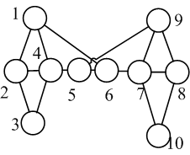
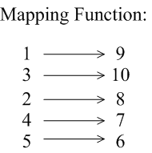
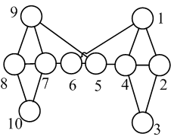
K-Automorphism Network
Graph isomorphism

Slide 26
The Motivation
If the released graph is a k-automorphism network,
It can resist any attack.
Problem Definition: Given an original network G, find a network G*, where G is a sub-graph of G*, and G* is a k-automorphic network. G* is published as G's anonymized version. Furthermore, we require that Cost(G,G*) is minimized.

Slide 27
KM Algorithm-(Overview)
Block Alignment
Edge Copy
Notes:
In this example, we first partition the graph G’ into two blocks, P1 and P2.
Then, we perform block alignment over these two blocks. In the example, we add edge“2-4”. After block alignment, we duplicate the “crossing edge”, called “edge copy”. In this way, we can get K-Automorphism graph.

Slide 28
Framework
Graph G
Remove Identifiable information
Graph G’
Block Alignment
Graph G*
Edge Copy
Graph G’’
Notes:
Generally, the framework of our approach is as follows:
Given a original graph G, we remove all “identifiable information”, such as names, to obtain a graph G’.
Then, we perform block alignment over G’ to obtain graph G’’.
After that, in “edge copy ” process, we duplicate all “crossing edges” to obtain G*, where G* is k-automorphism network.

Slide 29
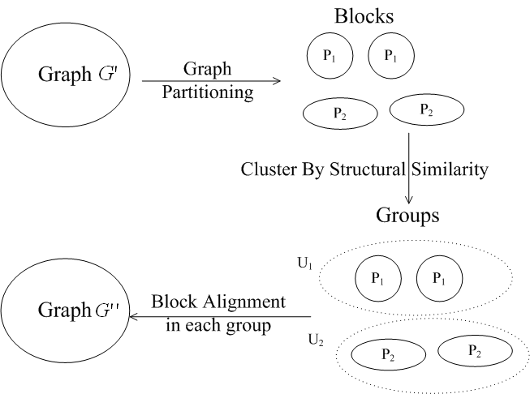
Block Alignment
2016/11/17
29
Notes:
In order to perform “block alignment”, we first partition graph G’ into n blocks.
After that, according to “structural similarity”, we cluster these blocks into m groups, where each group has at least k blocks.
For each group, we perform “block alignment” over all blocks in this group.

Slide 30
Block Alignment
Graph Partition
Block Alignment
2016/11/17
30
Notes:
30
As we know, different graph partitions will lead to different performance. Since the graph partition is related to block alignment, thus, we delay the discussion about “graph partition”.
We first discuss how to perform block alignment.
Assume that the original graph is partitioned into two parts P11 and P12, and they are in the same group. Thus, we need to alignment P11 and P12.

Slide 31
An Optimal Block Alignment
We prove the optimal block alignment is NP-hard
Notes:
In this example, the optimal block alignment is to add edge“2-4”.
After block alignment, we can get two isomorphic blocks. For each vertex in one block, there exist the corresponding vertex in another block.
We use “AVT” to denote the corresponding vertices. However, the optimal block alignment is NP-hard. Thus, we propose the heuristic algorithm, called degree-based block alignment.

Slide 32
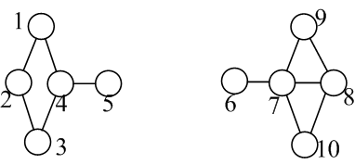
Degree-Based Alignment
The largest same degree
Vertex Alignment Table
4
8
1
9
3
10
5
7
BF-search
2
6
Pair-up vertices with the same or similar degrees
2016/11/17
32
Notes:
In degree-based alignment, we always pair-up the vertices with large degrees. The similar method is also adopted in “1-neighbor graph attack ”in [B. Zhou, ICDE08].
First, vertex 4 and 8 has the same degree. Furthermore, the degree is the largest one. Therefore, initially, we pair up vertex “4” and “8”.
After that, we perform “Breath-first-search ” from vertex 4 and 8 in two blocks in parallel.
During the BFS, we pair-up vertices with same or similar degrees.
At last, according to AVT, we introduce “corresponding” edges to perform “block alignment”
Obviously, this method will no lead to the optimal result, since it introduces 5 edges in this example. In the following running examples, we assume that we obtain the optimal “block alignment” and the corresponding VAT. This assumption is only for ease of “presentation”. It does not affect the correctness.
32

Slide 33
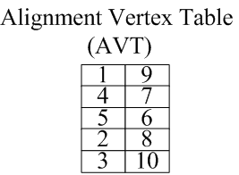
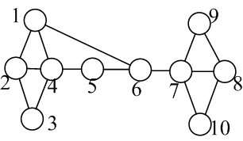
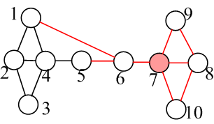
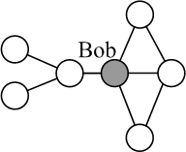
After Block Alignment
The privacy of Bob is still compromised
Query:
2016/11/17
33

Slide 34
Edge Copy
Crossing Edge
Edge Copy
2016/11/17
34
Notes:
34

Slide 35

Edge Copy
According to Automorphic Function, duplicate all crossing edges.
Alignment Vertex Table (AVT)
Crossing Edge
1 | 9
4 | 7
5 | 6
2 | 8
3 | 10
Automorphic Function: F(1)=9; F(9)=1; F(4)=7; F(7)=4; F(5)=6; F(6)=5; F(2)=8; F(8)=2; F(3)=10; F(10)=3;
35
Notes:
35
We use this example to show the method of “edge copy”.
The edge “1-6”is a crossing edge. According to AVT, we can find the corresponding vertices, that are “9” and “5”.
Thus, we introduce an edge “5-9”.

Slide 36
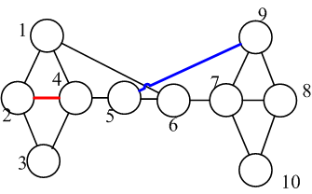
Cost
Edges introduced during edge copy
Given a group U_{i} of blocks P_{ij}, j=1,…,k, the anonymization cost of group U_{i} is defined as follows:
Cost(U_{i})= AlCost(U_{i})+0.5*(k-1)*∑_{j}|CrossEdge(P_{ij})|
Edges introduced during alignment
The total cost is the sum of all group costs.
2016/11/17
36
Notes:
The cost is defined to be the number of introduced edges.
According to our framework, we introduce edges in both “block alignment” and “edge copy”.
Given a group U_{i} of blocks P_{ij}, j=1,…,k, the number of introduced edges is denoted as “AlCost(Ui)”.
|CrossEdge(Pij)| denotes the number of “crossing edges” attached to this block.
For each crossing edge, we need to introduce “k-1” edges at most in “edge copy”. Each crossing edge is attached to two blocks. Therefore, 0.5 *(k-1)*|CrossEdge(Pij)| denotes the number of introduced edges in “edge copy” for block “Pij”.

Slide 37
Graph Partition
Objection of this step:
Partition graph G’ into n blocks, and cluster these blocks
into m groups U_{i}. Each group U_{i} has no less than k blocks.
2016/11/17
37
Notes:
37
As we know, different graph partitions will lead to different performance. Since the graph partition is related to block alignment, thus, we delay the discussion about “graph partition”. We first discuss how to perform block alignment. Assume that the original graph is partitioned into two parts P11 and P12, and they are in the same group. Thus, we need to alignment P11 and P12. As we know, different partitions will lead to different perforamnce. We will delay the discussion about “graph partition”, which is related to other problems..
In the following discussion, we assume that the whole graph is partitioned into n blocks. These blocks are clustered into m groups. Each group has no less than k blocks.

Slide 38
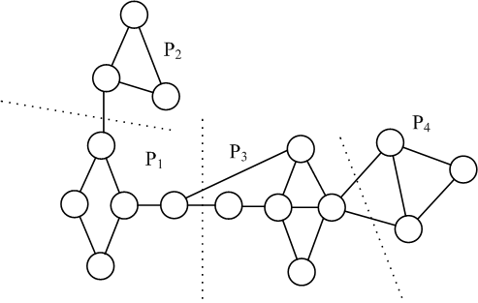
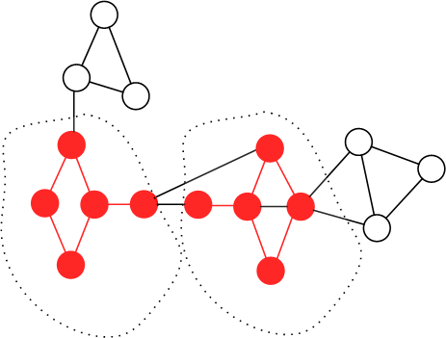
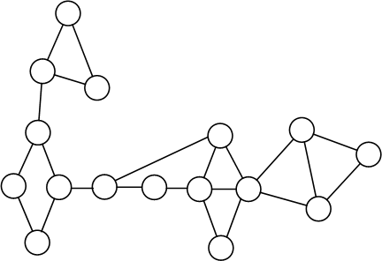
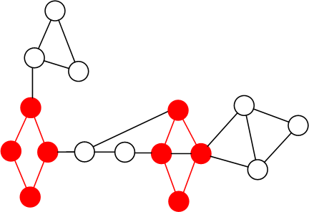
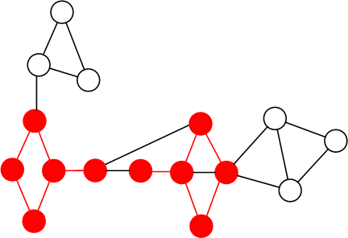
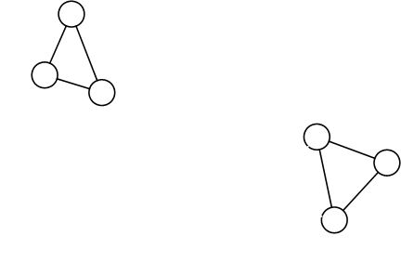
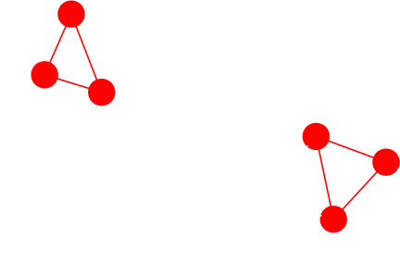
Graph Partition
Blocks in another group
1) Set Min_sup= k (i.e. k=2)
Blocks in one group
2) Find the matches of the largest frequent subgraphs (non-overlapping) as the initial group U of blocks.
3) Expand and alignment all blocks in the group U, until Cost(U) is increased.
4) Extract all blocks in group U from the original graph G.
Iterate Steps 1-3 until no vertices in Graph left.
2016/11/17
38
Notes:
We first use the frequent subgraph algorithm to find frequent subgraph. One subgraph is said to be frequent, if it has more than min_sup non-overlapping matches in the large graph G. The mining algorithm is proposed in [M. Kuramochi DMKD 05].
We set the support min_sup to be k.
Then, we find all matches of the largest frequent subgraph. These matches are collected to form the initial group U of blocks.
Then, we expand and alignment all bocks in group U. If the group cost is increasing, we stop the expansion.
After that, we extract all blocks in group U for the original graph G.
At last, we iterate Steps 1-3 until no vertices in Graph left

Slide 39
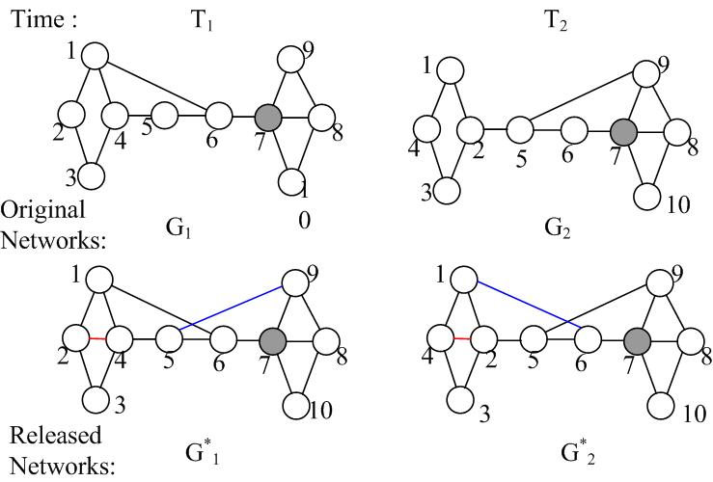
Dynamic Releases
2016/11/17
39
Notes:
39
Example 2: There are two released networks G1* and G2* in time T1 and T2, which both satisfy 2-automorphism principle.

Slide 40
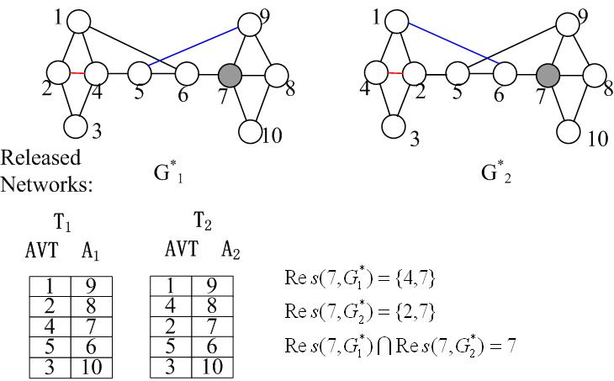
Vertex ID Generation
2016/11/17
40
Notes:
40

Slide 41
Vertex ID Generation
Generalized vertex
ID table
2016/11/17
41
Notes:
41

Slide 42
Link Protection
Models
K-degree
K-neighborhood
K-automorphism (K-symmetric)
Protection objective
Preventing node re-identification
Link Protection?
Notes:
[1] The K-degree anonymous, K-neighborhood anonymous and K-automorphism anonymous models all focus on preventing node re-identification. In some applications, the link information is sensitive too. These protection models should be extended to support Link Protection

Slide 43
Link Leakage in k-automorphism
A 2-automorphism graph
1
7
2
3
5
6
8
9
4
10
Candidates for Bob
Prob(con(Bob, Alice)) = 100%
Candidates for Alice
Notes:
[1] Let’s use the k-automorphism model to show the problem of these anonymous models when considering link protection.
[2] This graph is a 2-automorphism graph. There are two candidates for Bob and two candidates for Alice. Although the attacker cannot know which node is exactly Bob or Alice, since both candidates of Bob have links to both candidates of Alice.
[3] This attacker knows Bob and Alice has a link with 100% probability.

Slide 44
K-isomorphism ^{[22]}
K-isomorphism anonymous
The graph contains at least k disjoint isomorphism subgraphs
A 2-isomorphism graph
1
7
1
2
2
3
5
6
8
9
3
4
4
10
Candidates for Bob
Candidates for Alice
Notes:
[1] A k-isomorphism model is proposed in Sigmod 2010 which enhanced the k-automorphism model to support link protection
[2] A k-isomorphism graph is a graph ….
[3] (click) The candidates of a nodes will appears in all the isomorphism subgraphs. For two users, only the two candidates of them appear in the same subgraph, the have connections. Thus the probability an attacker can find two users have any connection is at most 1/k
[4] In this example, there are four possible assignments of Bob and Alice. (Click) only in assignments 1 and 2, Bob and Alice may have connections. Then the probability an attacker finds two nodes have relations is at most ½.
[5] Note here the connection is not restricted to direct link. The information such as two node is two hop or three hop neighbors is also connection information. Two nodes have connection only when they are in the same subgraph.

Slide 45
Publishing sanitized graph
Privacy protection and the attack models
Preventing passive attacks
Edge editing based models
Clustering based models
Preventing active attacks
Other works
Notes:
[1] Next we introduce clustering based protection models

Slide 46
Resist neighborhood attack through graph clustering^{[8]}
2
Step1: Partition the graph, each partition contains at least k nodes
1
1
3
2
2
2
Step2: For each partition, generate a super node
2
3
3
2
Step3: Draw the edges between partitions, the weight is the edge number
This paper used Simulated Annealing to minimize the number of sampling graphs:
Step3: Draw the sel-edges for each partition, the weight is the edge number with it
Notes:
[1] The clustering based protection model firstly partition nodes . Each partition contains at least k nodes.
[2] Then, for each partition, a super node is generated to represent it.
[3] Since the nodes are represented as super nodes, the edges are between super nodes now. There may be multiple edges between two super nodes. For example, between super node 1 and 2, there are three edges. These three edges are displayed as a super edge with weight 3.
[4] Similarly, the super edges between the nodes in one super nodes can be represented as super sel-edges.
[5] To prevent node re-identification, a clustering model just needs to make sure each super node’s size is at least k. Note the clustering based model can prevent the attack using any kind of subgraph knowledge since the nodes in the same cluster cannot be distinguished.
[6] Different clustering models use different cost function to do the partition. In paper [8], they used Simulated Annealing to minimize the number of sampling graphs.

Slide 47
K-anonymous masked^{[15]}
(a₁,a₂,..,a_{k})
1
2
(a₁’’,a₂’’,…,a_{k}’’)
A = Generalization Information Lost
B = Structural Information Lost
Cost = a*A + b*B
1
3
(a₁,a₂,..,a_{k})
2
(a₁’,a₂’,…,a_{k}’)
2
2
2
3
3
The algorithm is partition the graph into clusters bigger than k by minimizing this cost
2
Weight Protection
Notes:
[1] Other people also use a cost function which contain both the node labels and structures to guide the partition
[2] For example, each node has a group of attributes.
[3] When a group of nodes are put into a super node, their attributes will either be permuted or generalized as what tabular data does. Therefore, the information lost of node attributes can be represented as the generalization cost when make all the nodes in a super node have same attributes.
[4] The information loss on structures can be represented the possibility to correctly guess the position of an edge.
[5] A pinkdd 2008 paper designed such kind cost function and designed a heuristic algorithm to partition nodes target this cost function.

Slide 48
Clustering model for link protection ^{[13]}
Graph Model
Undirected bipartite graph (V, I, E)
V is a set of users
Each user has a group of attributes
I is a set of interactions
Each interaction can contain more than two users
Edge(v, i) means user v is involved in interaction I
Protect Objectives
Node protection:
Link protection 1:
user x and y are in any interaction together
Link protection 2:
user x is involved in interaction i
Notes:
[1] In VLDB 2009, a new clustering model was proposed to provide protections for both node and links
[2] This paper focused on a heterogeneous social network which can be represented as an undirected bipartite graph.
[3] The bipartite contains two node sets V and I.
[4] V is a set of users, each user has a group of attributes.
[5] I is a set of interactions. Each interaction can be involved by multiple users. For example, four users can play a game together.
[6] An edge (u,i) means user u is involved in interaction I.
[7] There are three protection objectives achieved by this paper. The first one is to preventing node re-identification. The probability that a user can be re-identified is at most 1/k. The other two objectives are for link protection. The probability that an attacker finds two nodes are involved in any interaction together is at most 1/k and the probability that can attacker finds a node is involved in an interaction is at most 1/k.
[8] It should be emphasized that the second privacy objective is the exactly to find whether two users have connection or not as the k-isomorphism model.

Slide 49
Graph Model Demo
u1: 29, F, NY
1
2
email1 : 1024 bytes on 1/3/08
u2: 20, M, JP
friend1 : added on 7/6/08
u3: 24, F, NK
3
4
game1 : score 8-3-6
u4: 31, M, NJ
email2 : 812 bytes on 1/2/08
u5: 18, M, NJ
5
blog1 : subscribed on 9/9/08
u6: 21, F, CA
6
blog2 : subscribed on 2/6/08
u7: 44, M, DE
7
V
I
Notes:
[1] This is an example of heterogeneous social network which is represented as a bipartite graph.
[2] Each user has a group of attributes such as name, sex and position.
[3] Two nodes can be involved in more than one interaction. For example, node 1 and 2 are friends. At the same time, they communicated by email.
[4] An interaction can also contain more than 2 users. For example, node 3, 4 and 5 play game1 together.
[5] The basic idea to publish such a graph is clustering the users in V.

Slide 50
Clustering graphs
{u1, u4, u6}
email1
email1
{u2, u5}
{u1, u2, u3}
friend1
friend1
{u3, u7}
game1
game1
{u1, u4, u6}
email2
{u4, u5}
email2
{u2, u5}
blog1
blog1
{u1, u4, u6}
{u6, u7}
blog2
blog2
{u3, u7}
Attacks using node attributes
Attacks using node attributes + structure information
Notes:
[1] The published graphs are like these.
[2] If an attacker can only use node attributes, after clustering, publish a graph with permutated node in each cluster is ok.
[3] If an attacker can use both node attributes and the structure information, as same as other clustering models, the connections are only displayed on clusters.
[4] It is obviously if each cluster has size at least k, the node protection is guaranteed. Next we show how to achieve the two link protection objectives.

Slide 51
Safety Clustering Condition
Safety Clustering Condition:
Case 1: u and v are friend
Case 2: u and v are friend
w
Interaction i
v
i
Interaction i
u
i
j
u
v
Interaction j
Cluster together
Cluster together
Notes:
[1] It showed if the clustering satisfies “Class Safety Property”, the two link protection objectives can be guaranteed.
[2] If we call two users who are involved in any interaction together as “friends”, this condition requires any two users who are put into the same super node cannot be friend or share common friends.
[3] If u and v (point to Case 1) are involved in the same interaction, they are friends, in this case, (click), u and v cannot be put into the same cluster
[4] If u and v share the same friend w (point to Case 2), (click) u and v are also not allowed to be assigned into the same cluster
[5] Next let’s demonstrate the intuitive logics behind this safety condition.

Slide 52
Safety Clustering Condition Cont.
k=2
Case 1: u and v are friend
Interaction i
v
v
Interaction i
i
i
u
u
Cluster together
Notes:
[1] If case 1 is not satisfied, (click), then this case may happens after clustering.
[2] Then, the probability that v or u is involved in i is 2/2 which is bigger than 1/2 (click)

Slide 53
Safety Clustering Condition Cont.
Case 2: u and v are friend
k=2
x
v
friend_k
x
Interactions
w
friend_i
k
u
friend_j
w
u
i
j
v
Cluster together
Notes:
[1] If two nodes are involved in the interaction k, we call they have relationship friend_k. For case 2, if it is violated, then this case may happens after clustering.
[2] Then, for node u and w, the probability that an attacker find they have connection is ¾, which is bigger than 1/k.

Slide 54
Safety Clustering Condition cont.
Case 1: u and v are friend
Case 2: u and v are friend
w
Interaction i
v
Interaction i
i
u
u
j
v
Interaction j
Any cluster
Any interaction
Any cluster
Any cluster
C
i
C₁
C₂
At most 1
friend
Notes:
[1] For case 1, any two nodes who are friends cannot be put into the same cluster, then we can get (click)
[2] For any cluster C and any interaction i, at most 1 node in C can be involved in i. (click) Since any cluster’s size is at least k, the probability that an attacker can link a user to a specific link is at most 1/k. The link protection objective 2 can be guaranteed.

Slide 55
Publishing sanitized graph
Privacy protection and the attack models
Preventing passive attacks
Edge editing based models
Clustering based models
Protecting edge weights
Preventing active attacks
Other works
Notes:
[1] There are also two works which do not care about node link protection. They suppose a weighted graph is published and only the weights on the edges should be protected. Nodes and links do not need to be protected.
[2] Next we introduce them respectively.

Slide 56
Noised edge weights ^{[17]}
Graph model: weighted graph
Protection objective
Hide the real value of edge weights
An attacker’s background knowledge
The published graph
Using the edge weights he saw to guess the original weights
Utility
Length of shortest paths
Method
Add gaussian randomization multiplication noise to edge weights
Has high probability to preserve the length of shortest paths
Notes:
[1] In ****, a paper discussed about how to protect the edge weights. They suppose the published graph is a weighted graph with weight on each edges.
[2] The protection objective is to hide the real value of edge weights.
[3] They suppose an attacker will observe the edge weights in the published graph and using them to guess the original values.
[4] So, the basic method to do the protection is adding random noise to edge weights.
[5] This paper designed a gaussian randomization multiplication noise adding mechanism. They prove this mechanism has high probability to preserve the length of shortest paths.

Slide 57
ICDE 10: Anonymous Weighted Graph ^{[24]}
Graph model: weighted graph
Protection objectives
Hide the weights or the orders of the weights
An attacker’s background knowledge
The published graph
Utility
Certain graph metrics (Can be modeled as the linear inequations between edges weights)
Single source shortest path tree
Some shortest paths
Notes:
[1] Another work in ICDE 2010 considered a similar problem.
[2] They want to protect the weights and the order of the weights.
[3] When setting new edge weights, they want to preserve certain graph metrics such as the single source shortest path tree or some shortest paths. Note different with the previous work, this work thought it is more important to preserve the paths themselves instead of their lengths.

Slide 58
Motivation Example
2
2
Naïve method to protect edge weights: random assigning
4
5
45
50
1
11
6
1
80
6
7
5
66
5
31
3
2
2
4
5
45
1
6
1
80
6
7
5
66
5
Shortest path tree from 1
Notes:
[1] They show the naïve method to protect edge weights by randomly assigning new edge weights always destroy some important graph structures such as the shortest path tree or shortest paths.
[2] For example ….

Slide 59
Motivation Example cont.
2
2
4
5
45
50
1
11
6
1
123
6
w(1,6) > w(1,2) + w(2,6)
w(1,5)+w(5,6) > w(1,2) + w(2,6)
7
5
3
66
5
31
Linear constraints to preserve the utility
2
2
4
5
45
50
Use Linear Programming solver to assign new weights. Thus the utilities are preserved
1
6
1
6
7
5
66
5
Linear Programming !!
Notes:
[1] Fortunately, these graph structure characteristics can be represented as linear constrains among edge weights.
[2] If the new edge weights satisfy these linear constraints, the corresponding graph structure characteristics are preserved.
[3] The linear programming is exactly designed to solve the problem with linear constrains.
[4] So, the basic idea of this paper is “Use Linear Programming solver to assign new weights to preserve utilities better”.

Slide 60
Solution Skeleton
Utility request:
shortest path tree etc.
LP model
Edge weights are variables
Linear Constraints
From the construction of this tree
Variables:
w(1,2), w(1,5), w(1,6), w(2,6), w(5,6)
Constraints:
w(1,6) > w(1,2) + w(2,6)
w(1,5)+w(5,6) > w(1,2) + w(2,6)
Variables:
w(1,2) = 45
w(1,5) = 66
w(1,6) = 123
w(2,6) = 50
w(5,6) = 31
All the edge weights
Solver
Notes:
[1] This is the solution skeleton, … Edge weights are variables. The utilities that will be preserved are modeled as linear constraints. For example, if the utility is “shortest path tree”, the linear constraints can be gotten from the construction process of this tree.
[2] For example, in our previous example, an ILP model can be built by make all edge weight as variables (Click, Click)
[3] Then, this model can be put to a solver to solver. (click), This LP solver can assign values to these weight variables by solving this model (click).
[4] So,

Slide 61
Motivation Example cont.
2
2
4
5
45
50
1
11
6
1
123
6
7
5
3
Variables:
w(1,2), w(1,5), w(1,6), w(2,6), w(5,6)
Constraints:
w(1,6) > w(1,2) + w(2,6)
w(1,5)+w(5,6) > w(1,2) + w(2,6)
66
5
31
Variables:
w(1,2) = 45
w(1,5) = 66
w(1,6) = 123
w(2,6) = 50
w(5,6) = 31
LP Solver
Notes:
[1] By replace all the edge weights with the output of the LP solver, a new weighted graph can be published
[2] This guarantees certain utilities such as some shortest paths are preserved.

Slide 62
The dilemma of a publisher
(…)
User: I need to protect my privacy
Miner: I want useful information
Soft Request
(…)
(…)
Utility
Privacy
Utility
Privacy
Hard Request
☹
miner
☺
user
user
user
☺
miner
☹
user
Miner
miner
(…)
(…)
data
I don’t want to buy the data
I don’t want to provide my data
Case 1
Case 2
11/17/2016
Notes:
[1] A data publisher should make the published data satisfy the requirements of both the customers who require the graph data and the users who involve in the graph.
[2] The customers prefer the published data close to the original graph.
[3] For the users who join in the social network, they need to make sure their privacy information is protected. This is a hard request since if a user’s privacy cannot be guaranteed, he will refuse to join the social network.
[4] If using the current techniques, all the users can only be protected at the same level. If all the users' privacy is protected well, we must choose the strongest protection for all of them. In this case, the published graph is often faraway from the original graph. As a result, the data obtained by the customers is not useful. The customers will refuse to use this data.
[5] If the publisher satisfies the customer who requires the graph data by providing a weak protection to all users, some users may worry about their privacy and quit this social network.
62

Slide 63
Utility
Privacy
☺
miner
miner
☺
user
user
?
11/17/2016
Notes:
Is it possible to find a solution to satisfy the requirements of both the customers who require the graph data and the users who involve in the graph?
63

Slide 64
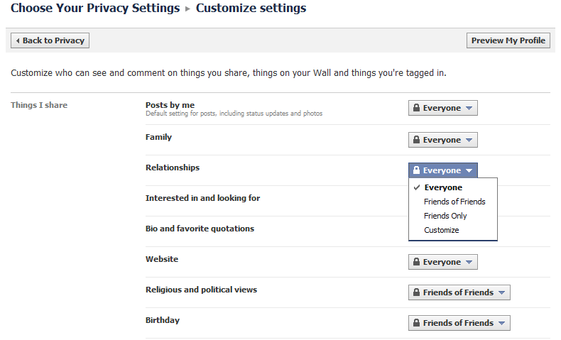
Social Network Websites Support ..
11/17/2016
Notes:
[1] Let’s see what is supported by the current social network websites. This is the customize privacy setting panel provided by Facebook.
[2] We can see, each user is freely to set how part of information can be seen by others
[3] He can set who can see his profile information and who can see his connection information as well.
64

Slide 65

As a Result …
People can only read my posts
Alice
People can only read my posts and my favorite questions
Bob
People can only read my posts , my favorite questions and may relationships
Chilly
… …
11/17/2016
Notes:
[1] As a result, the knowledge that an attacker can use to attack a user is only the information that this user released out
[2] For example, Alice …, Bob published more information than Alice, …, Chilly published even more than Bob …
[3] Each user has a clear definition about the knowledge that can be used by an attacker
[3] Although the privacy requirement is a hard request that must be satisfied, it is not necessary to provide the same protection to all the users.
[3] We can take the advantage of the customized setting to increase the utility of the published graph
65

Slide 66
Protection strategies …
Published Information
{u₁}
1
2₁, 2₂
3
…
m
{u₂}
stronger
{u₃}
{u₄}
{u₅}
11/17/2016
Notes:
[1] depends on the different settings of users, the published information can be organized as a Pyramidal
66

Slide 67
Protection strategies …
Published Information
Corresponding Attacks
Request
{u₁}
1
2₁, 2₂
3
…
m
Based on 1
Prevented for {u₁}
{u₂}
Based on 2
Prevented for {u₂}
stronger
{u₃}
Based on 3
Prevented for {u₃}
{u₄}
… …
… …
{u₅}
Based on m
Prevented for {u_{m}}
11/17/2016
Notes:
[1] If for each user, we can prevent the attacks based on the corresponding information, then all the users’ privacy requirements are satisfied
67

Slide 68
Current Protection strategies …
Published Information
Corresponding Attacks
Request
{u₁}
1
2₁, 2₂
3
…
m
Based on 1
☺
{u₂}
☺
Based on 2
stronger
{u₃}
☺
Based on 3
{u₄}
☺
… …
{u₅}
☺
Based on m
Prevented for all
Data buyer:
☹
11/17/2016
Notes:
[1] As we mentioned before, if using the current techniques, one choice is to provide the strongest protection to all the users. Then users are satisfied but the customers might not like it
68

Slide 69
Protection strategies …
Published Information
Corresponding Attacks
Request
{u₁}
1
2₁, 2₂
3
…
m
Based on 1
☺
{u₂}
☺
Based on 2
stronger
{u₃}
☺
Based on 3
Prevented for all
{u₄}
☹
… …
{u₅}
☹
Based on m
Data buyer:
☺
11/17/2016
Notes:
[1] The other choice is to provide a middle level protection to all the users. The customers may be satisfied but some users may in trouble
69

Slide 70
Ideal Protection Strategies
Published Information
Corresponding Attacks
Request
{u₁}
1
2₁, 2₂
3
…
m
Based on 1
☺
Prevented for {u₁}
{u₂}
☺
Based on 2
Prevented for {u₂}
stronger
{u₃}
☺
Based on 3
Prevented for {u₃}
{u₄}
☺
… …
… …
{u₅}
☺
Based on m
Prevented for {u_{m}}
Data buyer:
☺
11/17/2016
Notes:
[1] The function of social network websites that allows users to do customized setting provides us a good opportunity to solve this problem
[2] If we can build a protection framework that provides different user protections based on their customized setting, we can satisfy both the requirements of the customers and users. That is we maximize the utility of the published graph without violating users’ privacy.
70

Slide 71
In this paper …
Published Information
Corresponding Attacks
1
2
3
Request
Knowledge 1
Level 1 attack
Level 1 protection
Node attributes
{u₁}
Based on 1
Prevented for {u₁}
Node attributes
Degree
stronger
{u₂}
Based on 2
Prevented for {u₂}
Node attributes
Degree
Edge attributes
{u₃}
Based on 3
Prevented for {u₃}
11/17/2016
Notes:
[1] In this paper, suppose there are three levels of information. The weakest one is …. The second one is …. The strongest one is …. Of course there may exist stronger information such as the 1-hop, 2-hop neighborhood graphs etc. We focus on demonstrating a framework which can publish a social network and satisfy different levels of privacy protection requirements. We will not enumerate all of them.
[2] We call the level X knowledge as Knowledge X and the protection to it as Level X protection.
71

Slide 72
Our Protection Goal
11/17/2016
For nodes
An attacker can re-identify a node with probability at most 1/k
For edges
An attacker can re-identify two nodes u and v has a connection with probability at most 1/k
An attacker can re-identify a node u is involved in an edge e in the published graph with probability at most 1/k
Notes:
[1] We provide protections for both nodes and edges in our framework
[2] For nodes …
[3] For edges …
72

Slide 73
Bottom up protection
Published Information
1
2
3
{u₁}
Node attributes
Node attributes
Degree
stronger
{u₂}
Node attributes
Degree
Edge attributes
{u₃}
11/17/2016
Notes:
[1] Here is our solution. The published information is from the weakest to the strongest.
[2] Level 1 is node attribute protection. Level 2 is node attribute protection and degree protection. Level 3 is node attribute protection , degree protection and edge attribute protection. It is obviously that level 3 contains level 2, level 2 contains level 1.
73

Slide 74
Bottom up protection
Published Information
1
2
3
Pyramidal
Bottom Up
Protect
{u₁ , u₂ , u₃}
Node attributes
{u₁ , u₂ , u₃}
Node attributes
Degree
stronger
{u₂, u₃}
Enhance
{u₂, u₃}
Node attributes
Degree
Edge attributes
Enhance
{u₃}
{u₃}
11/17/2016
Notes:
[1] So the nodes which need level 3 protection by default need level 2 and level 1 protection. The nodes can be organized as a pyramidal and we can implement the personalized protection from the bottom to top
[2] Firstly, we provide protections based one level 1 knowledge for all the nodes
[3] Then we enhance the nodes that need level 2 and level 3 protections to reach level 2 protection
[4] Finally we enhance the nodes that need level 3 protection to reach level 3 protection
74

Slide 75
Avoid Attacks Using Knowledge 1
Method: Node protection
Grouping + Node attributes permutation
Group ID | Node attributes
… | …
3 | [1] Asian, 33, Phd [2] American, 26, master [3] African, 27, master
… | …
7 | [1] European, 29, Phd [2] American, 40, bachelor [3] Australian, 35, bachelor
… | …
M | …
k=3
0: friend
1: family
Group 3
0
… …
0
1
1
0
1
Group 7
11/17/2016
Notes:
[1] For level 1 protection, since the attacker knows the node attributes, we use the grouping plus node attributes permutation method. We divide the nodes into groups such that each group has size at least k. Then the node attributed are published based on groups.
[2] Since each group has size at least k, we can guarantee the success probability of node re-identification is at most 1/k
75

Slide 76
Avoid Attacks Using Knowledge 1
Method: Node protection
Grouping + Node attributes permutation
Edge protection (Two safety conditions)
[1] Make sure No edge within a group
[2] Control the number of edges between groups
k=3
0: friend
1: family
0
[1] attribute list 1
[2] attribute list 2
[3] attribute list 3
Bob
Alice
→ Chilly
… …
0
0
1
1
0
Each user has 2/k probability to have this edge
1
11/17/2016
Notes:
[1] To protect edges, we let the dividing of nodes satisfy two safety conditions
[2] The first condition is to make sure there is no edge within a group. This is to guarantee the probability that an attacker finds a user is involved in an edge is at most 1/k
[3] For example, if there is an edge within a group, based on the node attributes related with this group, an attacker knows Bob, Alice and Chilly are in this group. Then any of them has probability 2/k to be involved in this edge. This violates one of the edge protection requirements
76

Slide 77
Avoid Attacks Using Knowledge 1
Method: Node protection
Grouping + Node attributes permutation
Edge protection (Two safety conditions)
[1] Make sure No edge within a group
[2] Control the number of edges between groups
k=3
0: friend
1: family
0
X
{p₁, p₂, p₃}
… …
0
1
d edges
1
0
1
{p₄, p₅, p₆}
Y
11/17/2016
Notes:
[1] The second condition controls the number of edges between any two groups must be less than a threshold
[2] For example, if there are d edges between two groups, an attacker may find users {p1,p2,p3} are in group X and users {p4, p5, p6} are in group Y based on their attributes. If the d/(|X||Y|) is less than 1/k, we can make sure the probability an attacker finds two users have a connection is less than 1/k
77

Slide 78
Avoid Attacks Using Knowledge 2
Objective: For any group that contains one node need this level’s protection, make all the nodes in it have the same degree
Method: Add noise edges/nodes under the two safety conditions
k=3
0: friend
1: family
0
… …
0
1
1
0
1
11/17/2016
Notes:
[1] After all nodes reach level 1 protection, we need to enhance protection of the nodes who need level 2 protection or above to level 2 protection
[2] Since the level 2’s information is node attributes and node degree, we can make all the groups which have nodes that need level 2 protection or above only contain nodes with the same degree. We implement this by increasing the node degrees
78

Slide 79
Avoid Attacks Using Knowledge 2
Objective: For any group that contains one node need this level’s protection, make all the nodes in it have the same degree
Method: Add noise edges/nodes under the two safety conditions
k=3
0: friend
1: family
0
0
… …
0
1
1
0
1
1
11/17/2016
Notes:
[1] We first create edges between nodes whose degree needs to be increased under the two safety conditions
[2] If there are still some nodes cannot reach their target degrees, we use some noise nodes to achieve the goal
79

Slide 80
Avoid Attacks Using Knowledge 2
Objective: For any group that contains one node need this level’s protection, make all the nodes in it have the same degree
Method: Add noise edges/nodes under the two safety conditions
k=3
1
0: friend
1: family
0
0
1
… …
0
1
0
0
1
0
1
1
1
11/17/2016
Notes:
[1] We create noise node groups and connect the noise nodes with the nodes whose degrees need to be increased
[2] We make sure this process does not violate the two safety conditions and the noise nodes do not stand out.
80

Slide 81
Avoid Attacks Using Knowledge 3
Objective :For any group that contains one node need this level’s protection, make all the nodes in it have the same degree label sequence
Method: Generalize the edge labels
k=3
1
0: friend
1: family
0
0
1
… …
0
1
0
0
1
0
1
1
1
11/17/2016
Notes:
[1] In the last step, we enhance the protections to those nodes who need level three protection
[2] Since the level 3’s knowledge is the node attributes, degree and edge labels, we generalize the edge labels to those groups that contain at least one node needing level 3 protection
[3] Suppose this group contains one node who needs level 3 protection
81

Slide 82
Avoid Attacks Using Knowledge 3
Objective :For any group that contains one node need this level’s protection, make all the nodes in it have the same degree label sequence
Method: Generalize the edge labels
k=3
1
0: friend
1: family
0
{0,1}
{0,1}
… …
0
1
0
0
{0,1}
0
1
1
1
11/17/2016
Notes:
[1] If the edge labels on these three edges are generalized, level 3 protection is achieved
82

Slide 83
Publishing sanitized graph
Privacy protection and the attack models
Preventing passive attacks
Preventing active attacks
Other works
Notes:
[1] Next, we introduce two works that target on active attacks

Slide 84
Anti Active attack
Anonymized Data
(…)
(…)
(…)
Facebook
(…)
(…)
Government
Advertiser
Analyze and reveal some privacy information
Filtering
Web agents
Marketing
Customers
Users
Notes:
[1] The key point to preventing an active attack is filtering the noise nodes out.
[2] The filtering is based on the differences between the normal nodes and noise nodes.
[3] So the filtering depends on how an attacker changes the network.
[4] The current two works all focus on a special attack named Random Link Attack on email social networks.

Slide 85
RLA on email networks ^{[11]}
Random link attack (RLA)
A group of noise nodes
Form communities themselves
Preventing to be filtered as outlier nodes
Randomly link to a large number of victims
Notes:
[1] A random link attack is that an attacker uses a group of noise nodes to connect a large number of normal nodes. That is, sending spam emails to a lot of users, even a small portion replied, a lot of connections are successfully built.
[2] Since a normal user will form communities with his friends, the attacker always make the noise nodes densely connected to avoid be filtering out as outliers.
[3] So there are two basic characteristics of RLA: the first is that the noise nodes form communities themselves; the other is these noise nodes connect with a large number of victims.
[4] Based on these two characteristics, noise nodes may be filtered out.

Slide 86
Observations
noise
normal
Most of its friends know each other
[1] Victims are randomly selected
Most of their friends do not have connection
The noise nodes form communities
Cluster Coefficient is small
Triangle ratio is very low
Cluster Coefficient is large
Triangle ratio is high
Notes:
[1] For a noise nodes, since the victims he connected is randomly selected and he can not expect who will reply his spam email, most of the victims do not have connection.
[2] (Click) As a result, the neighborhood of a noise node has small cluster coefficient and the triangle ratio is very low.
[3] For a normal node, most of its friends know each other.
[4] (Click) As a result, the neighborhood of a normal node has large cluster coefficient and the triangle ratio is high.
[5] (Click) Another character of noise nodes is that the noise node form communities.

Slide 87
Two step filtering
noise
normal
Cluster Coefficient is small
Triangle ratio is very low
Cluster Coefficient is large
Triangle ratio is high
The noise nodes form communities
Find suspects
Filtering the densely connected nodes around all suspects
Notes:
[1] A work in ICDE 07 designed a two step filtering algorithm based on these observations.
[2] Firstly, based on the difference between the neighborhood graphs of noise and normal nodes, the algorithm finds a group of suspects.
[3] Since the noise nodes form communities, the second step searches the neighborhood of each suspects and removes all the densely connected nodes around these suspects.

Slide 88
Two step filtering
noise
normal
Cluster Coefficient is small
Triangle ratio is very low
Cluster Coefficient is large
Triangle ratio is high
The noise nodes form communities
Find suspects
Filtering the densely connected nodes around all suspects
Notes:
[1] A work in ICDE 07 designed a two step filtering algorithm based on these observations.
[2] Firstly, based on the difference between the neighborhood graphs of noise and normal nodes, the algorithm finds a group of suspects.
[3] Since the noise nodes form communities, the second step searches the neighborhood of each suspects and removes all the densely connected nodes around these suspects.

Slide 89
Find suspects by spectral characteristics ^{[25]}
noise
normal
Spectral values
i.e. the values eigen vectors
Different
Spectral values
i.e. the values eigen vectors
The noise nodes form communities
Find suspects
Filtering the densely connected nodes around all suspects
Notes:
[1] An work in ICDE 2011 find the spectral values of a noise node and a normal nodes have obvious difference.
[2] They proposed a new method based on the spectral analysis of the adjacent matrix to find suspects.
[3] The second step is the same. …

Slide 90
Publishing sanitized graph
Privacy protection and the attack models
Preventing passive attacks
Preventing active attacks
Other works
Notes:
[1] There are two related works which are not in “Preventing passive” attacks and “Preventing active attacks”.

Slide 91
Other Works^{[10][20]}
un-trustable
How to embed a re-identifiable subgraph with minimum nodes
How to safely compose a large id anonymized graph through the sub-graphs gathered from agencies
Cryptographic based protocol
trustable
trustable
Web agents
Users
Notes:
[1] There’s one work in www 07 talks about “How to embed a re-identifiable subgraph with minimum nodes”. Since this work does not focus on protection models, we ignore the detailed introducing to it.
[2] Another work studies “How to safely compose a large id anonymized graph through the sub-graphs gathered from agencies”. Here the id anonymized means only remove all the names of nodes.
[3] In real life, each web agent only holds the sub-graph of users who trust it. There does not exist a server whom all agents trust. Thus no agent will give its subgraph to others. A cryptographic based protocol should be designed to aggregate subgraphs to a large graph. This work used commutative encryption to implement this protocol

Slide 92
Outline
Information Sharing in On-line Social networks
Understanding Your Privacy Risk
Managing Your Privacy Control
Notes:
This is the outline of this class.
We firstly demonstrate the information sharing in on-line social networks
Then we discuss some works who designed strategies to help on-line users understanding their privacy risk
Finally, we introduce some works on designing tools to support users’ privacy management in on-line social networks.

Slide 93

Information Sharing in Social Networks
Millions of users share details of their personal lives with vast networks of friends, and often, strangers
Notes:
There are numerous social networks now. People may join different networks to get different services. As a result, a lot of personal information are shared out. The privacy issue becomes a key challenge. Millions of users share details of their personal lives with vast networks of friends, and often, strangers

Slide 94
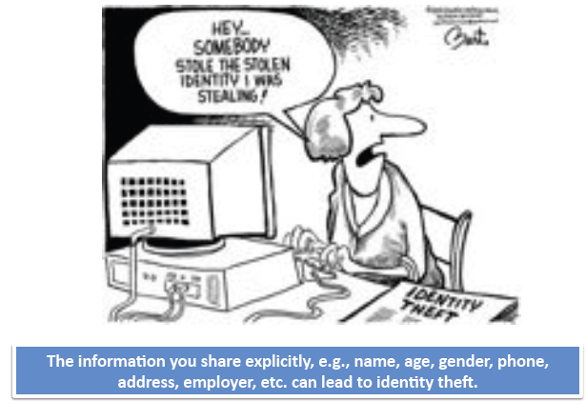
What is the Privacy Risk of On-line Social network Users
Notes:
The information a user share, such as name, age, gender, phone, address, can lead to identify theft.
We must have a tool to let a user know the privacy riak.

Slide 95
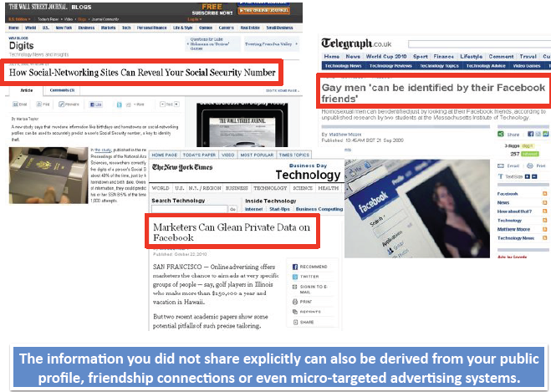
Scenarios
Notes:
Sometimes, even you did not share explicit information, there may still have privacy problem.
The information can be derived from your public profile, friendship connections or even micro-targeted advertising system.
There are many works have demonstrated this problem.

Slide 96
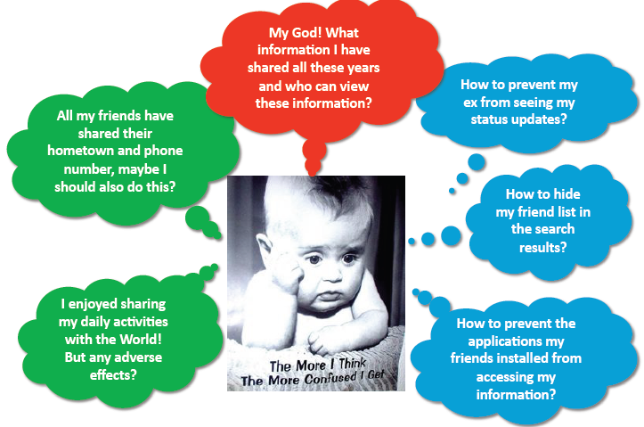
The Sad Situation
Notes:
The sad situation now is that the privacy protection tools for on-line users are far behind the information sharing speed since the social networks are explosion in recent years.
****

Slide 97
The Sad Situation con’t
You have control on what information you want to share, who you want to connect with
You do not have comprehensive and accurate idea of the information you have explicitly and implicitly disclosed
Setting online privacy is time consuming and many of you choose to accept the default setting
Eventually you lose control … and you are facing privacy risk
Notes:
You have control on what information you want to share, who you want to connect with
You do not have comprehensive and accurate idea of the information you have explicitly and implicitly disclosed
Setting online privacy is time consuming and many of you choose to accept the default setting
Eventually you lose control … and you are facing privacy risk

Slide 98
Outline
Information Sharing in On-line Social networks
Understanding Your Privacy Risk
Privacy risk due to what you shared explicitly
Managing Your Privacy Control
Notes:
So, the first important work is to design strategies to help users understand their privacy risk due to that they shared explicitly

Slide 99
Privacy risk due to what you shared explicitly
Basic Idea
Privacy risk is measured by Privacy Score^{[1]}
Privacy Score takes into account what information you’ve shared and who can view that information
Basic Premises of Privacy Score
Sensitivity
The more sensitive the information revealed by a user, the higher his privacy risk
Visibility
The wider the information about a user spreads, the higher his privacy risk
Notes:
The basic idea is to measure the privacy risk by a privacy score.
Privacy Score takes into account what information you’ve shared and who can view that information
Basic Premises of Privacy Score includes
Sensitivity
The more sensitive the information revealed by a user, the higher his privacy risk
Visibility
The wider the information about a user spreads, the higher his privacy risk

Slide 100
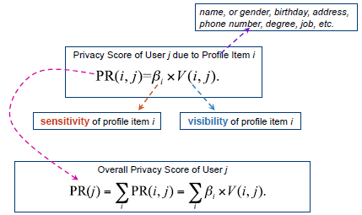
The framework
Notes:
A privacy score of user j due to Profile item i can be computed use this formula.
In it, *****

Slide 101
Outline
Information Sharing in On-line Social networks
Understanding Your Privacy Risk
Privacy risk due to what you shared explicitly
Privacy risk due to what you shared implicitly
Managing Your Privacy Control
Notes:
The second category of works is to analyze the privacy risk due to what you shared implicitly

Slide 102
What is node classification?
19 UST
UST
20 UST
College friend
UST
20
High school friend
40, UHK
Notes:
For example, we have this network, some people do not provide some attributes in their profile since they do not want to share them.

Slide 103
What is node classification?
?
?
19 UST
?
UST
20 UST
College friend
?
UST
20
?
High school friend
40, UHK
?
?
Notes:
However, leave them blank cannot guarantee the protection of these attributes

Slide 104
Privacy Risk due to What You Shared Implicitly
Privacy information can be inferred from
Your public profile, friendships, group memberships, etc.
Private information can be inferred using
Majority voting^{[1][2]}
Community detection^{[3]}
Classification^{[1][4]}
Notes:
As we learned in the previous classes. There are many method to infer the blank attributes.
Privacy information can be inferred from
Your public profile, friendships, group memberships, etc.
Private information can be inferred using
Majority voting^{[1][2]}
Community detection^{[3]}
Classification^{[1][4]}

Slide 105
Classification Methods
Naive Method
Based on network distribution
Local Classification Methods
Based on friendship links
AGG, BLOCK, LINK
Based on social groups
CLIQUE, GROUP, GROUP*
Based on both links and groups
LINK-GROUP
Iterative Classification Method (CC)
Random Walk Based Methods
Notes:
There are many inference algorithms.

Slide 106
Outline
Information Sharing in On-line Social networks
Understanding Your Privacy Risk
Privacy risk due to what you shared explicitly
Privacy risk due to what you shared implicitly
Tools to visualize your privacy policies
Managing Your Privacy Control
Notes:
The last category of work is how to design proper tools to visualize the users’ privacy policies.

Slide 107
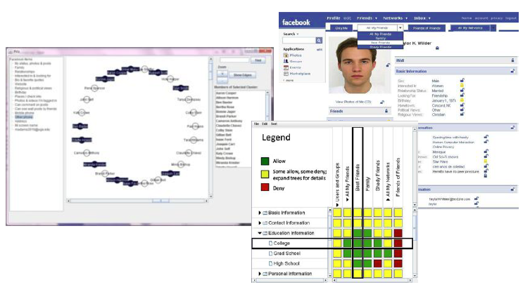
Tools to Visualize Privacy Policies
Visualizations significantly impact users’ understanding of their privacy settings^{[5][6]}
Notes:
Here are some examples of the visualization tools. The visualizations significantly impact users’ understanding of their privacy settings^{[5][6]} .

Slide 108
Facebook
Notes:
Actually, you can facebook’s privacy setting panel. This is a simple example to display users’ privacy rules.

Slide 109
Outline
Information Sharing in On-line Social networks
Understanding Your Privacy Risk
Privacy risk due to what you shared explicitly
Privacy risk due to what you shared implicitly
Tools to visualize your privacy policies
Managing Your Privacy Control
Notes:
The other important category of works is to design good privacy wizard to help users to manage users’ privacy

Slide 110
Privacy Management of Individuals
Social Navigation^{[1][7]}
Preventing Inference Attacks^{[4]}
Learning Privacy Preferences with Limited User Inputs^{[8][9]}
Notes:
The privacy manage of individuals includes three categories:
Management in social navigation
Preventing inference attacks
And
Learning Privacy preferences with limited user inputs

Slide 111
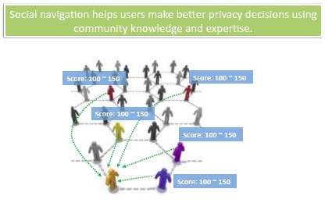
Social Navigation
Notes:
Social navigation helps users make better privacy decisions using community knowledge and expertise.

Slide 112
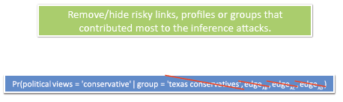
Preventing Inference Attacks
Notes:
To prevent inference attacks. We can remove or hide risky links, profiles or groups that contributed most to the inference attacks.
For example, the probability to guess a user’s political views can be greatly decreased by removing some public information.

Slide 113
Learning Privacy Preferences
Privacy Wizards for Social Networking Sites
Best student paper in WWW 10
Notes:
An important problem is to design convenient tools to support users’ privacy setting. It is better to be easy understanding, easy manipulating and intellegent.

Slide 114
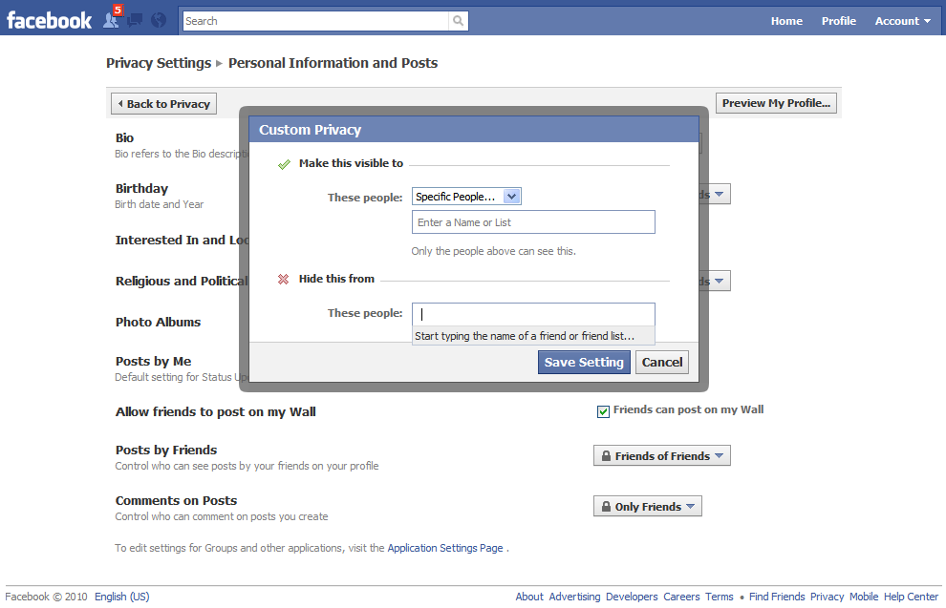
Privacy preference setting in Facebook
Notes:
Here is the privacy setting tools used by facebook. It allows user to set which part of a user’s prifle can be seen or cannot be seen by which categories of people.
It is reported that most people actually use this wizard.
How many of you use facebook, please rise your hand?
How many of you have ever configured your privacy through facebook’s wizard?
So, people begin to use machine learning algorithms to design better privacy setting tools. Let’s one work in WWW 2010, which is the best student paper from UM.

Slide 115
Problem and Challenges
Interface
Interface + wizard
Profile
Gender
Age
…
Education
Friends
List 1
List 2
…
List N
Profile
Gender
Age
…
Education
Friends
List 1
List 2
…
List N
Allow to see
Deny to see
M
N
AI engine that based on communities
MN mappings
Problem
User need to manually create user lists
Too many friends (average 130 in facebook)
Users are not familiar with complex privacy rules
Solution: a privacy wizard based on an implicit set of rules
Challenges
Low Effort, High Accuracy
Graceful Degradation
Visible Data
Time consuming
Notes:
Nowadays, with the rapid growth of social networks, each people many have hundreds even thousands of friends. If there are M items in a user’s profile and this user has N friends. There are M times N mappings. If setting one by one, it becomes an impossible task.
The challenges here is:
User need to manually create user lists
Too many friends (average 130 in facebook)
Users are not familiar with complex privacy rules
This makes the privacy setting very time consuming, even not possible to do the setting.
The solution

Slide 116
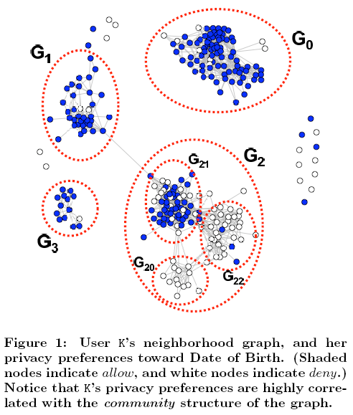
Basic observation
The privacy setting is related with the communities in a user’s neighborhood graph
Off-line extract features:
[1] Community Structure
[2] Other profile information
Using classifier to recommend the friend list based on users current settings
Using classifier to recommend the friends that the classifier is most uncertain about them.
Recommend the user to set these friends’s privacy in the next step

Slide 117
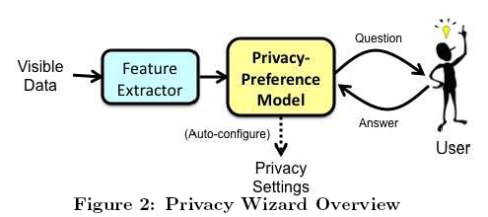
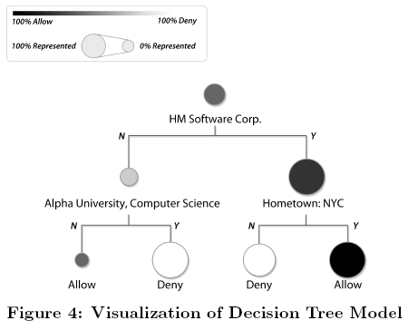
Structure and Enhancement
For experienced users, let himself to select the next setting friends
Display a decision tree to represent the classifier
Decision distribution
Number of labeled friends in each node

Slide 118
Summary
You have certain control of the information you are sharing
You often cannot estimate the long term risk vs. shot term gain
Algorithms to measure potential privacy risks due to information shared either explicitly or implicitly
Models to alleviate your burden on privacy management

Slide 119
Future Works
A widely accepted privacy score that boosts public awareness of the privacy risk
An end-to-end practical system to measure and manage privacy online

Slide 120
References
K.Liu and E.Terzi. A framework for computing privacy scores of users in online social networks. In ICDM 2009
J.Becker and H.Chen. Measuring privacy risk in online social networks. In W2SP 2009.
A.Mislove, B.Viswanath, K.Gummadi, P.Druschel. You are who you know: Inferring user profiles in online social networks. In WSDM 2010.
J.Lindamood, R.Heatherly, M.Kantarcioglu, B.Thuraisingham. Inferring private information using social network data. In WWW 2009
A.Mazzia, K.LeFevre, and E.Adar. A tool for privacy comprehension. In CHI 2011.
H.Lipford, J.Watson, M.Whitney, K.Froiland, R.Reeder. Visual vs. compact: a comparison of privacy policy interfaces. In CHI 2010.
A.Besmer, J.Watson, and H.Lipford. The impact of social navigation on privacy policy configuration. In SOUPS 2010.
L.Fang and K.LeFevre. Privacy wizards for social networking sites. In WWW 2010.
M.Shehab, G.Cheek, H.Touati, A.Squicciarini, and P.Cheng. Learning based access control in online social networks. In WWW 2010.

Slide 121
References
L. Sweeney, “k-anonymity: a model for protecting privacy,” Int. J. Uncertain. Fuzziness Knowl.-Based Syst., vol. 10, no. 5, pp. 557–570, October 2002. [Online].
P. Samarati, “Protecting respondents identities in microdata release,” IEEE Transactions on Knowledge and Data Engineering, vol. 13, pp. 1010–1027, 2001.
A. Machanavajjhala, J. Gehrke, D. Kifer, and M. Venkitasubramaniam, “l-diversity: Privacy beyond k-anonymity,” in 22nd IEEE International Conference on Data Engineering, 2006.
N. Li and T. Li, “t-closeness: Privacy beyond k-anonymity and ?-diversity,” in In Proceedings of IEEE International Conference on Data Engineering, 2007.
X. Xiao and Y. Tao, “M-invariance: towards privacy preserving re-publication of dynamic datasets,” in SIGMOD ’07: Proceedings of the 2007 ACM SIGMOD international conference on Management of data. New York, NY, USA: ACM, 2007, pp. 689– 700.
Raymond, Ada, K. Wang, and J. Pei, “Minimality attack in privacy preserving data publishing,” in VLDB ’07: Proceedings of the 33rd international conference on Very large data bases. VLDB Endowment, 2007, pp. 543–554.
M. E. Nergiz, M. Atzori, and C. Clifton, “Hiding the presence of individuals from shared databases,” in SIGMOD ’07: Proceedings of the 2007 ACM SIGMOD international conference on Management of data. New York, NY, USA: ACM, 2007, pp. 665–676.
M. Hay, G. Miklau, D. Jensen, D. Towsley, and P. Weis, “Resisting structural re-identification in anonymized social networks,” Proc. VLDB Endow., vol. 1, no. 1, pp. 102–114, 2008.
L. Backstrom, C. Dwork, and J. Kleinberg, “Wherefore art thou r3579x?: anonymized social networks, hidden patterns, and structural steganography,” in WWW ’07: Proceedings of the 16th international conference on World Wide Web. New York, NY, USA: ACM Press, 2007, pp. 181–190.
N. Shrivastava, A. Majumder, and R. Rastogi,“Mining (social) network graphs to detect random link attacks,” in Data Engineering, 2008. ICDE 2008. IEEE 24th International Conference on, 2008, pp. 486–495.
X. Ying and X. Wu, “Randomizing social networks: a spectrum preserving approach,” in SDM. SIAM, 2008, pp. 739–750.
K. Liu and E. Terzi, “Towards identity anonymization on graphs,” in SIGMOD ’08: Proceedings of the 2008 ACM SIGMOD international conference on Management of data. New York, NY, USA: ACM, 2008, pp. 93–106.
S. Bhagat, G. Cormode, B. Krishnamurthy, and D. Srivastava. Class-based graph anonymization for social network data. Proc. VLDB Endow., 2(1): 766–777, 2009.

Slide 122
References cont.
B. Zhou and J. Pei, “Preserving privacy in social networks against neighborhood attacks,” in Data Engineering, 2008. ICDE 2008. IEEE 24th International Conference on, 2008, pp. 506–515.
A. Campan and T. M. Truta, “A clustering approach for data and structural anonymity in social networks,” in 2nd ACM SIGKDD International Workshop on Privacy, Security, and Trust in KDD (PinKDD2008), Las Vegas, Nevada, 2008.
E. Zheleva and L. Getoor, “Preserving the privacy of sensitive relationships in graph data,” in First ACM SIGKDD Workshop on Privacy, Security, and Trust in KDD (PinKDD 2007), 2007.
L. Liu, J. Wang, J. Liu, and J. Zhang, “Privacy preserving in social networks against sensitive edge disclosure,” Department of Computer Science, University of Kentucky, Tech. Rep. CMIDA-HiPSCCS 006-08, 2008.
C. Wang and L. Chen, “Protecting data network privacy by breaking the structure-attribute association” 2008.
A. Korolova, R. Motwani, S. U. Nabar, and Y. Xu, “Link privacy in social networks,” in CIKM ’08: Proceeding of the 17th ACM conference on Information and knowledge management. New York, NY, USA: ACM, 2008, pp. 289–298.
F. Kerschbaum and A. Schaad, “Privacy-preserving social network analysis for criminal investigations,” in WPES ’08: Proceedings of the 7th ACM workshop on Privacy in the electronic society. New York, NY, USA: ACM, October 2008, pp. 9–14. [Online]. Available: http://dx.doi.org/10.1145/1456403.1456406
"K-automorphism: A General Framework for Privacy Preserving Network Publication“, VLDB 2009
“K-isomorphism: privacy preserving network publication against structural attacks”, Sigmod 2010
“K-Symmetry Model for Identity Anonymization in Social Networks”, EDBT 2010
“Anonymizing Weighted Social Network Graphs”, ICDE 2010
“Spectrum Based Fraud Detection in Social Networks”, ICDE 2011

